Slide 1
Linked
in
edunet
foundation
AI CAREERS FOR
WOMEN
LINKEDIN FELLOWSHIP
📊
P R E S E N T A T I O N 2 0 2 6
ECHOLENS: AI-POWERED FACULTY FEEDBACK
INTELLIGENCE FOR ACCELERATED ACADEMIC
DECISION-MAKING
Mentor Name
Faculty Name
Student Email
Faculty of Law
Marwadi University
AICW Fellowship 2026
[UMASHREE]
Parul Shukla
[parul.shukla@marwadieducation.edu.in]

Slide 2
edunet
foundation
Outline
⚙️
Abstract of the Project
Embedded Video of Project
Problem Statement
Conclusion
Proposed Solution
Future Scope
System Architecture
Live Demo of the Project

Slide 3
edunet
foundation
Abstract
Project Overview: AI-assisted pipeline converting raw student feedback into faculty-specific, action-ready insights within 48 hours – vs 12–15 working days manually.
🎯
Business Problem: 70–80% of qualitative feedback goes unanalysed. QA teams lose 40–50% of working hours each semester to manual comment review.
Solution Stack: Built with Microsoft Excel, Power BI and Microsoft Copilot – entirely low-code so non-STEM faculty can operate it without specialist training.
Faculty of Law
Marwadi University
AICW Fellowship 2026
Measured Impact: 85% faster turnaround · ~70% less manual effort · ~60% more actionable themes · 100% audit-ready and NAAC / NBA traceable.

Slide 4
edunet
foundation
Problem Statement
Core Issues Hindering Effective Academic Feedback Intelligence Include :-
Reduced Operational Efficiency – QA coordinators lose 40–50% of working hours to manually reading, categorising and summarising open-ended comments each semester.
⚠️
Reduced Faculty Productivity – Corrective teaching insights arrive 12–15 working days after collection, too late to benefit the cohort that raised the concern.
Difficulty in Evidence Verification – Institutions struggle to link improvement actions to source feedback rows during NAAC / NBA accreditation audits.
Existing Tools Gap – Excel cannot extract sentiment; standalone NLP tools require coding skills most non-STEM faculty do not have.
Stakeholder Breadth – Impacts faculty, HoDs, QA coordinators, IQAC, Deans and 500+ students each semester.

Slide 5
edunet
foundation
Proposed Solution
Core Components of the 3-Layer Low-Code Pipeline Include :-
BUSINESS
OUTCOMES
1
Clean & Structure (Excel + Power Query)
Auto-anonymise PII, normalise 1–5 ratings, remove duplicates, run schema checks on raw CSV feedback.
85%
Faster Turnaround
15 days → 2 days
2
Interpret (Microsoft Copilot / AI Chatbot)
Prompt-driven sentiment tagging, theme extraction across 6 categories, per-faculty teaching-improvement actions.
~70%
Less Manual Effort
3
Visualise & Decide (Power BI Dashboard)
KPI cards, sentiment trends, theme frequency charts, faculty drill-down — every insight tile traceable to source rows.
~60%
More Insights
per Course
100%
Audit-Ready
Traceability

Slide 6
edunet
foundation
SYSTEM ARCHITECTURE
EchoLens
📥 Data Input
🔧 Cleaning
🤖 AI Analysis
📊 Dashboard
Google Forms / LMS
Excel + Power Query
Microsoft Copilot
Power BI Desktop
• Raw CSV export
• De-duplicate rows
• Sentiment tagging
• KPI cards
• Ratings 1–5
• Anonymise PII
• Theme extraction
• Trend charts
• Open comments
• Normalise ratings
• Action reports
• Faculty drill-down
▶
▶
▶
🗄 Storage: OneDrive / SharePoint — Version-controlled, access-restricted, audit-ready | 📄 Output: Word + PDF per-faculty action reports

Slide 7
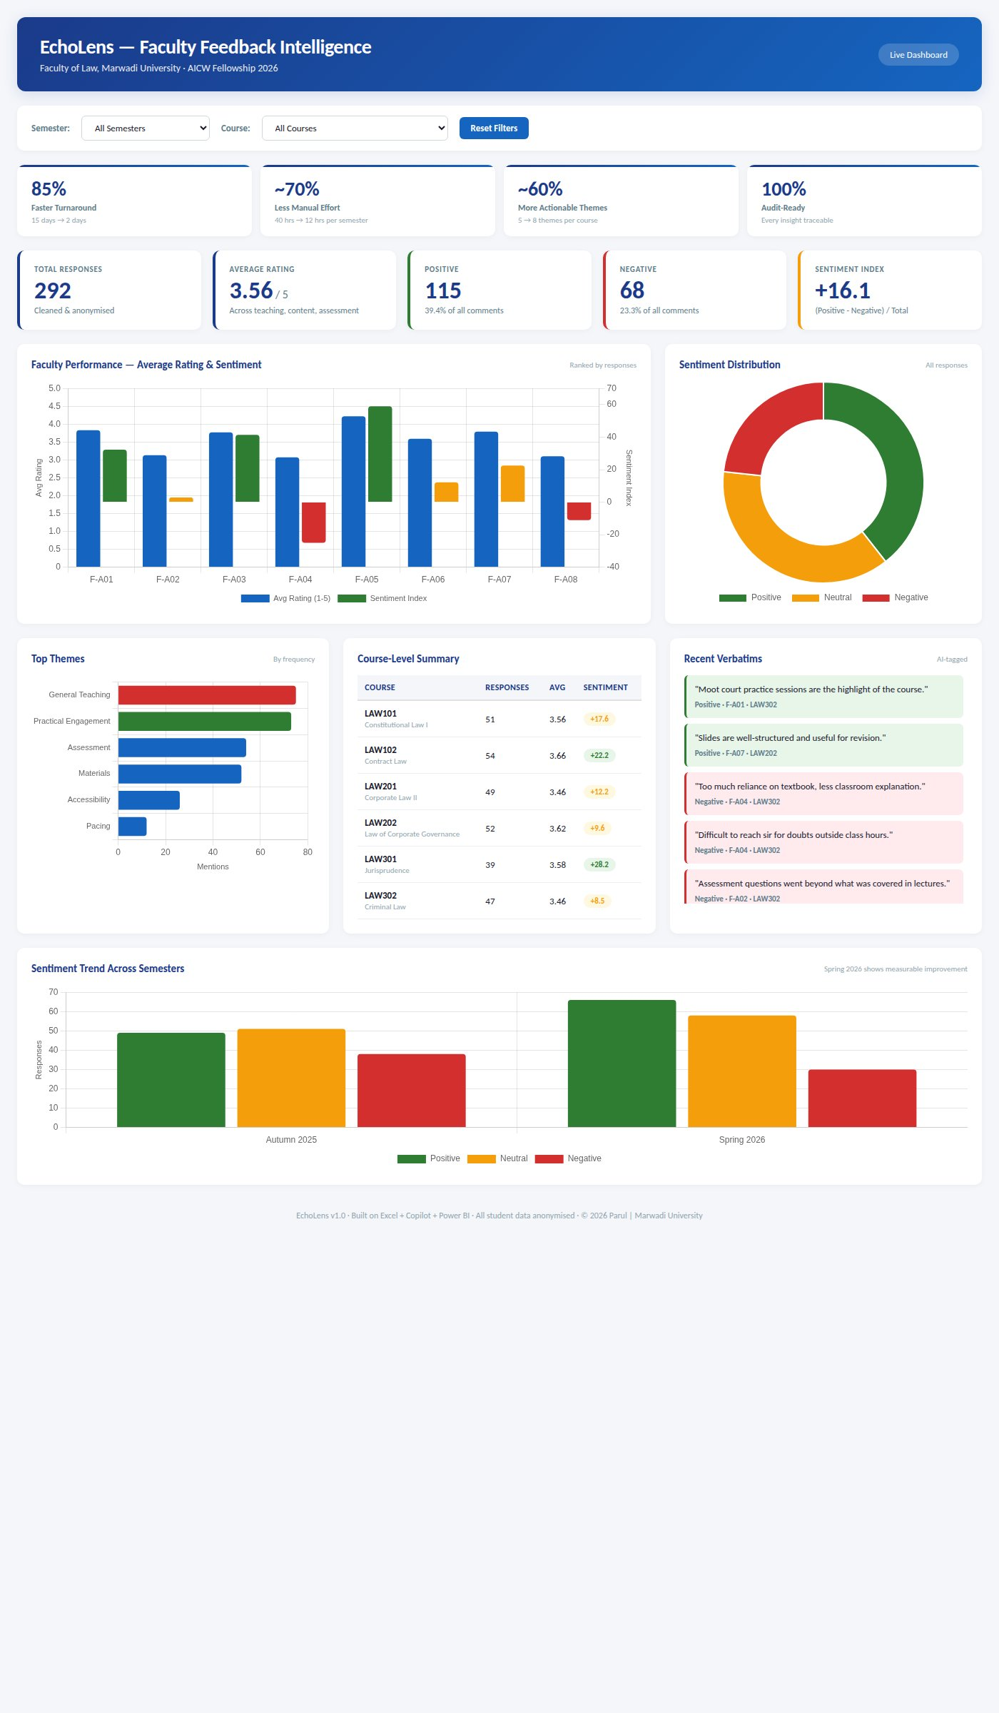
edunet
foundation
Live Demo of Project
Here's the list of some demo screenshots / features of the project:
🐙 GitHub Repository
🎬 Video Presentation
🖼️ Screenshots
All project files, datasets, prompt library, workbook and presentation hosted here.
End-to-end walkthrough: raw CSV → cleaned data → Copilot insights → Power BI dashboard.
Power BI dashboard, cleaned Excel workbook and AI-generated per-faculty action report.
https://github.com/parulshukla2026/Parul-s-AI-Women-Project-
https://github.com/parulshukla2026/Parul-s-AI-Women-Project-/blob/main/EchoLens_Video_Clean.mp4
[]
[ GitHub QR ]
▶

Slide 8
edunet
foundation
Embedded Video of Project Demo
▶
Walkthrough: raw CSV →
cleaned data → Copilot insights
→ Power BI dashboard
https://drive.google.com/file/d/1oNIbhzxQGFHrVpY6TZwoIoAdxsXoyZxV/view?usp=sharing
🔗 https://github.com/parulshukla2026/Parul-s-AI-Women-Project-

Slide 9
edunet
foundation
EchoLens Dashboard — Key Features
📊 KPI Cards
85% faster · 100% traceable
💬 Sentiment Index
Positive / Neutral / Negative
🏫 Course-Level Summary
All 6 law courses
📈 Semester Trend
Autumn 2025 → Spring 2026

Slide 10
edunet
foundation
Data Description & Workbook
305 synthetic responses · 6 law courses · 8 faculty members · 2 semesters (Autumn 2025 & Spring 2026) · Realistic data-quality issues included.
Field | Description | Type
response_id | Unique feedback row identifier | Source
semester | Autumn 2025 / Spring 2026 | Source
faculty_id | De-identified code (F-A01 … F-A08) | Source
rating_teaching / content / assessment | 1–5 Likert scale | Source
comment | Open-ended free text | Source
sentiment (derived) | Positive / Neutral / Negative — AI tagged | Derived – AI
theme (derived) | Materials / Pacing / Assessment / Accessibility… | Derived – AI
avg_rating (derived) | Mean of three rating fields | Derived – Excel

Slide 11
edunet
foundation
Conclusion
EchoLens converts unused qualitative feedback into a decision-ready pipeline that scales across departments and semesters. All AICW Fellowship objectives have been met.
✅ CONCLUSION
85%
~70%
~60%
100%
Faster Turnaround
15 days → 2 days
Manual Effort
Reduction
More Actionable
Themes per Course
Audit-Ready
Traceability
Freed QA capacity can be redirected to curriculum design, faculty development and audit preparation.
Within-semester intervention is possible because insights arrive before course completion.
Accreditation evidence (NAAC / NBA) is generated as a by-product, not a separate project.

Slide 12
edunet
foundation
Future Scope
Near-term (3–6 months)
🧠
• Direct Google Form / LMS API integration to remove manual CSV export step.
• Multilingual support for Hindi, Gujarati and other regional languages.
Medium-term (6–12 months)
• Predictive early-warning model flagging at-risk courses mid-semester.
• Auto-generated NAAC / NBA evidence pack for each accreditation cycle.
Roadmap: prototype → institution
Long-term (1 year+)
• Institution-wide rollout with role-based Power BI workspaces for HoDs, Deans and IQAC.
• Benchmarking layer to compare departments anonymously across the university.

Slide 13
edunet
foundation
Thank You
AICW Fellowship | Faculty Project Presentation 2026
LinkedIn | Edunet Foundation |
-
📢

